Slide 1



Mission Zero
Your chance to run an experiment using the Raspberry Pi
On board the International Space Station
James Preece (M0JFP) Chertsey Radio Club

Slide 2
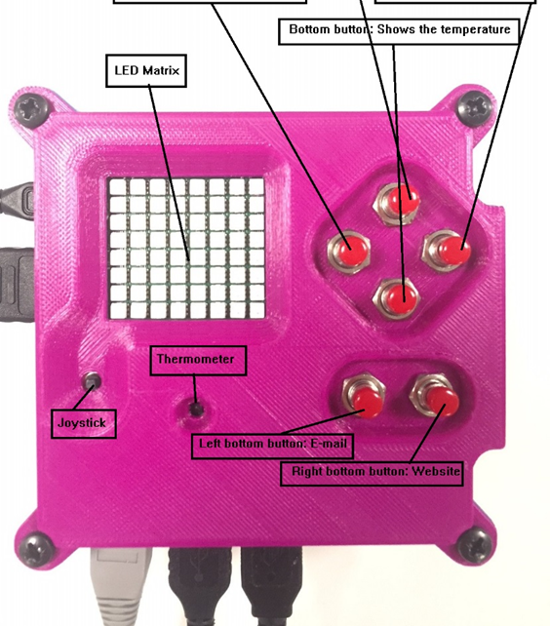
Hands on Astro-Pi

Slide 3
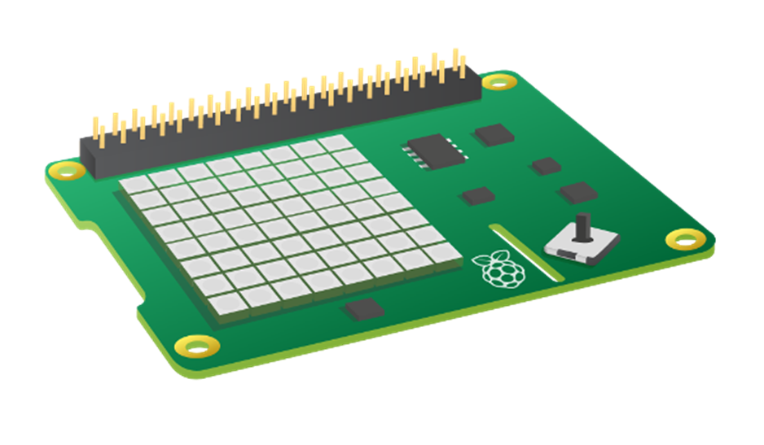
What is sense hat?
The Sense HAT is an add-on board for the Raspberry Pi, made especially for the Astro Pi competition. The board allows you to make measurements of temperature, humidity, pressure, and orientation, and to output information using its built-in LED matrix.

Slide 4
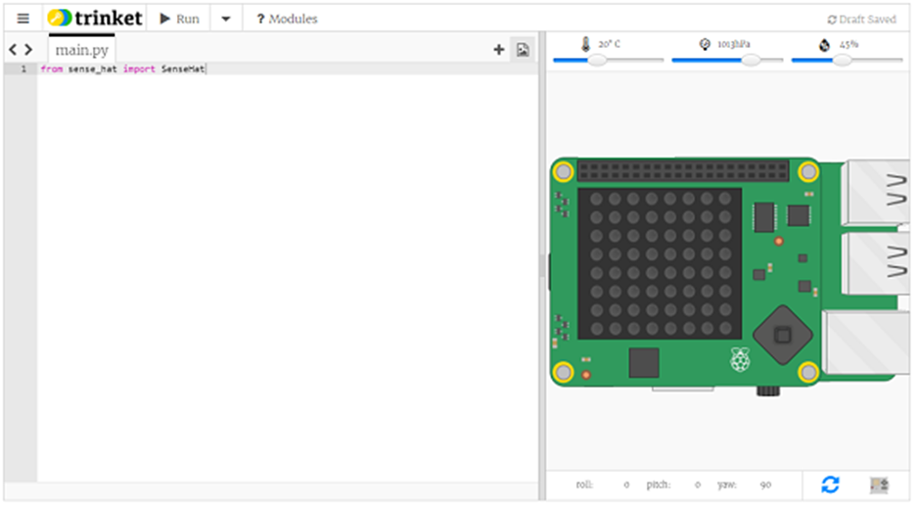
Online Sense HAT emulator
https://trinket.io/sense-hat
Allows you to experiment, using existing computer without buying the extra hardware

Slide 5

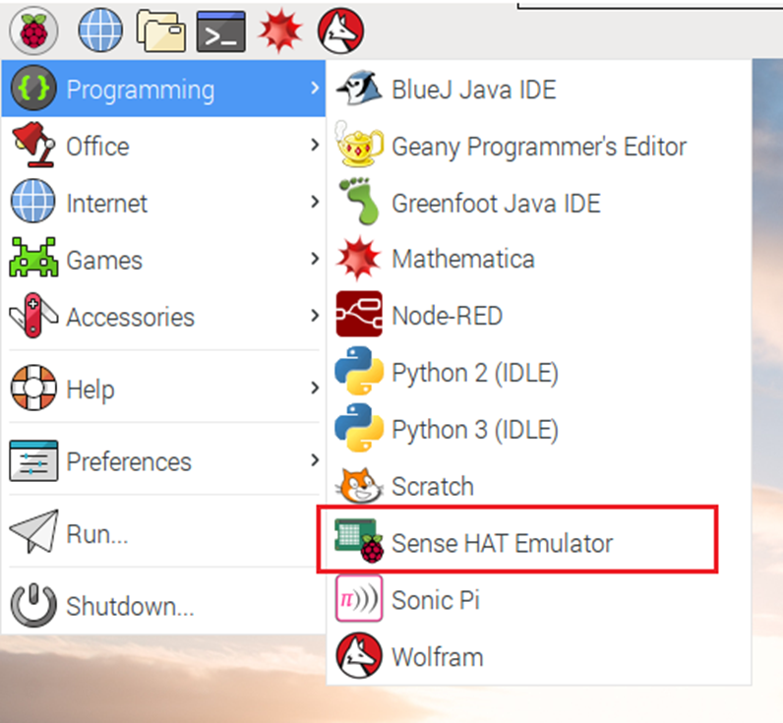
Sense HAT emulator on the Raspberry Pi
If you are using a Raspberry Pi, there is a Sense HAT emulator included in the Raspbian operating system.
From the main menu, select Programming > Sense HAT emulator to open a window containing the emulator.
If you are using this version of the emulator, your program must import from sense_emu instead of sense_hat:
If you later want to run your code on a real Sense HAT, just change the import line as shown below. All other code can remain exactly the same.

Slide 6
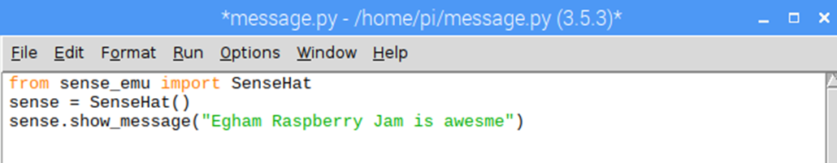
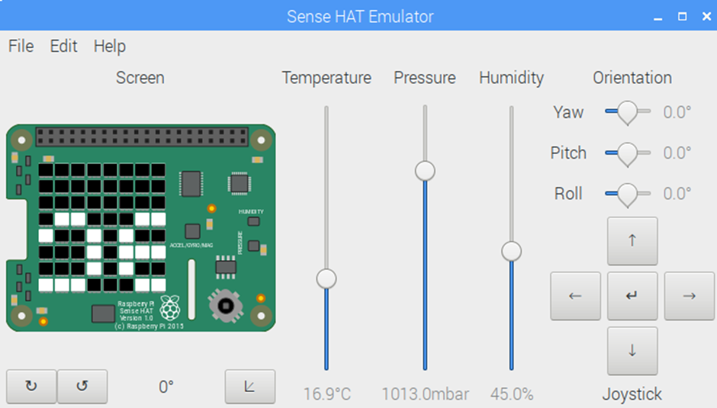
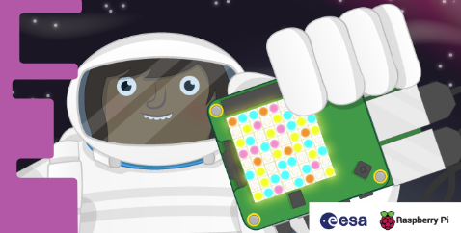
Displaying text
Display the text “Egham Raspberry Jam is awesome” on your Sense HAT’s LED display.
Now click on Run and Run Module, you should see the emulator pop up and your message start to scroll on the screen.
Please have a go at displaying your name or message, what did you need to change?
Please ask if you need some help!

Slide 7
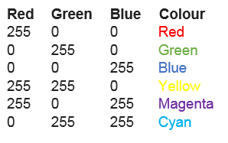
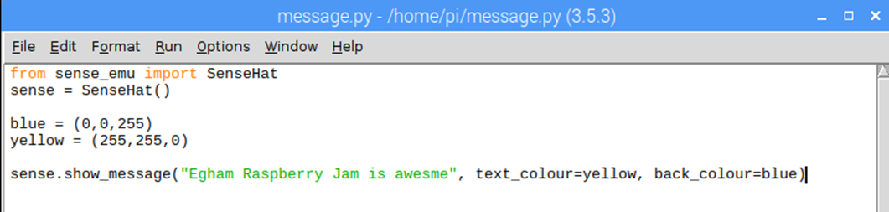
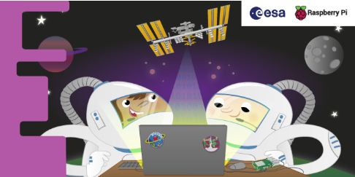
ADDING COLOUR
When we want to represent a colour in a
computer program, we can do this by defining the amounts of red, blue, and green that make up
that colour. These amounts are usually stored as a single byte and therefore as a number between 0 and 255.
text_colour: alters the colour of the text and is defined via three values to specify red, green, and blue.
back_colour: alters the colour of the background
Now let’s make our message a little more colourful
Can you change the text and background colours?

Slide 8
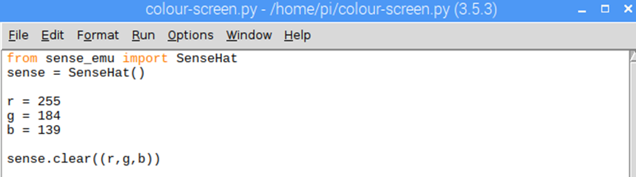
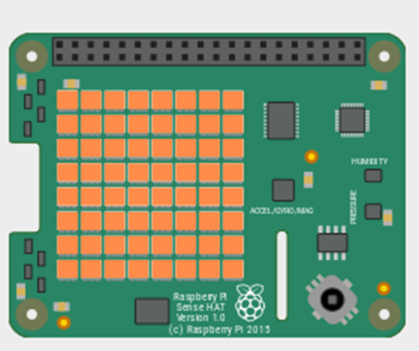
Display colour
You can fill the whole LED matrix with a single colour by using the clear method with the colour you’ve picked.
Can you change the display colour?

Slide 9
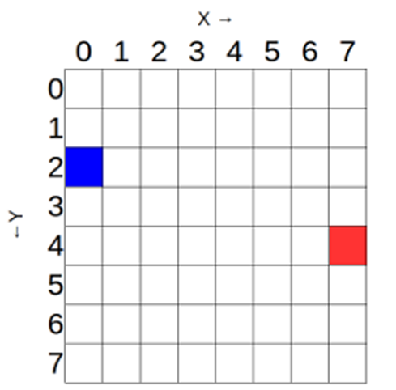
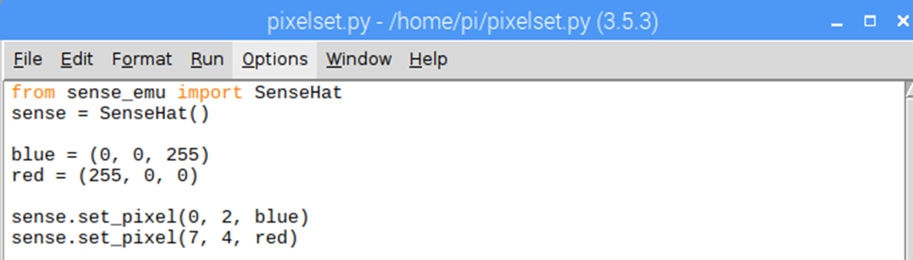
Display a picture
The Sense HAT’s LED matrix uses a coordinate system with an x- and a y-axis. The numbering of both axes begins at 0 (not 1) in the top left-hand corner. Each LED can be used as one pixel of an image, and it can be addressed using an x, y notation.
The blue pixel is at coordinates 0, 2.
The red pixel is at coordinates 7, 4.
You can set pixels (LEDs) individually using the set_pixel() method.
Can you light up the pixels (LEDs) in the four corners of the matrix in a colour of your choice.

Slide 10
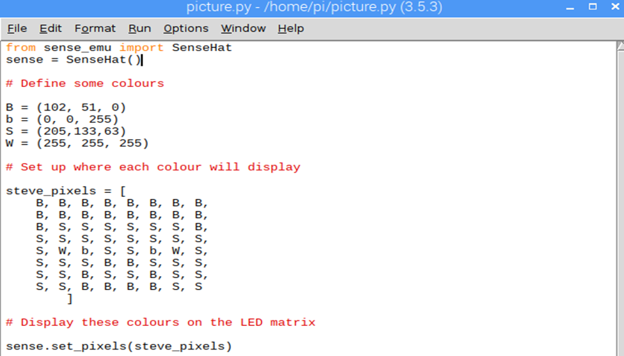
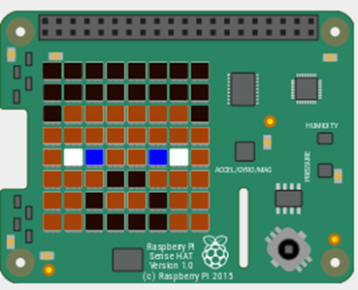
Setting multiple pixels
Setting pixels individually can work brilliantly, but it gets rather complex when you want to
set multiple pixels.
You may be tempted to try to draw shapes on the Sense HAT’s LED matrix by using the set_pixel command over and over. However, there is a set_pixels command with which you can change all 64 LEDs using
one single line of code!
Have a go with the code below and see if you can create your own Steve from Minecraft

Slide 11
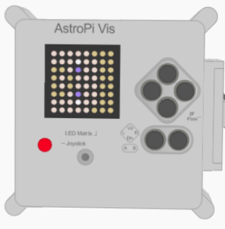
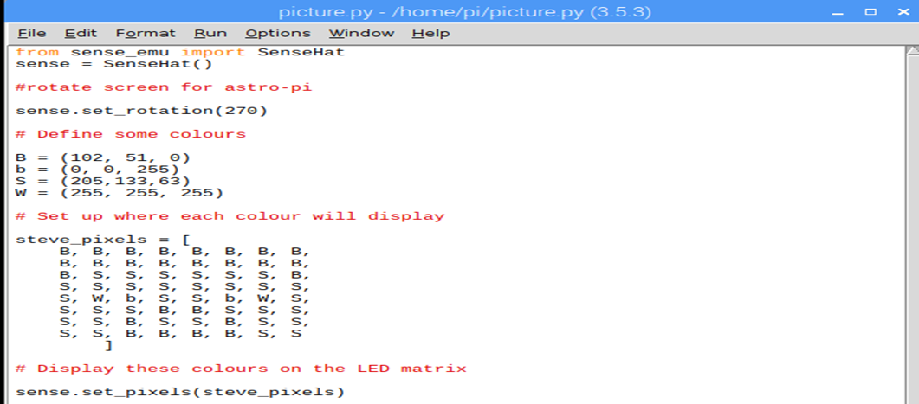
Setting orientation
So far, all our text and images have appeared the same way up, with the HDMI port at the bottom. However, this may not always be the true orientation of the Sense HAT (especially in outer space), so sometimes you might want to change the orientation of the LED matrix.
You can change the orientation of the LED matrix display on the Sense HAT. Use the set_rotation()
method to rotate the screen one of four ways: by 0, 90, 180, or 270 degrees.
For example, to rotate your display by 180 degrees you’d use this code
Oh no! Steve is sideways!

Slide 12
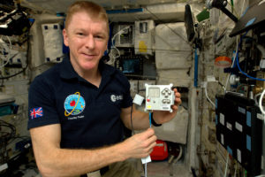
Sensing the environment
Reading pressure with the Sense HAT
pressure = sense.get_pressure()
print(pressure)
Detecting temperature with the Sense HAT
temp = sense.get_temperature()
print(temp)
Detecting humidity with the Sense HAT
humidity = sense.get_humidity()
print(humidity)

Slide 13
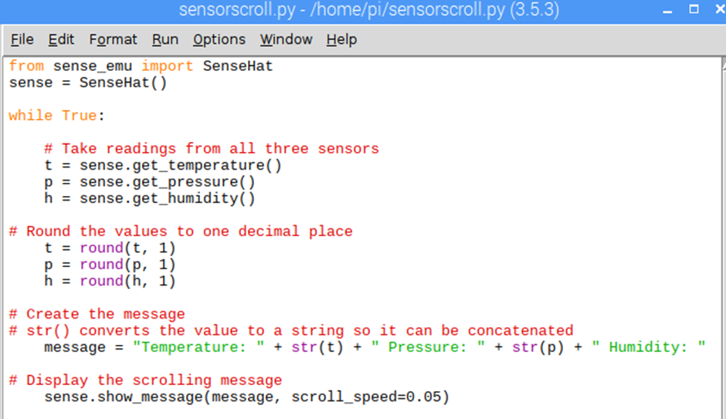
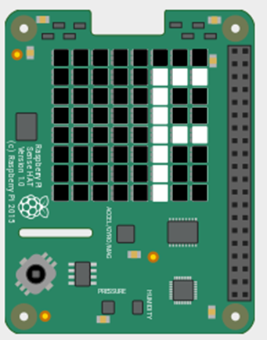
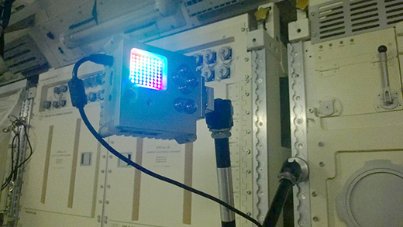
Display the sensor outputs
Create a scrolling text display which keeps people informed about the current pressure, temperature, and humidity readings.
Notice we are now forcing the rotation of the display to work with Astro-pi (ISS)

Slide 14

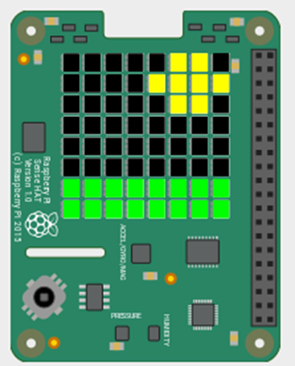
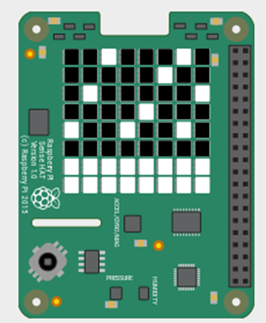
Grand finale
Let’s create a useful example from everything we just learnt.
In groups (min 2, max 4)
1: Create a greetings message (with your name’s)
2: Measure and display the temperature
3: Show a picture on the display
Can you display an image depending on the temperature?
If its hot maybe a sunshine, if it’s cold some snow?

Slide 15
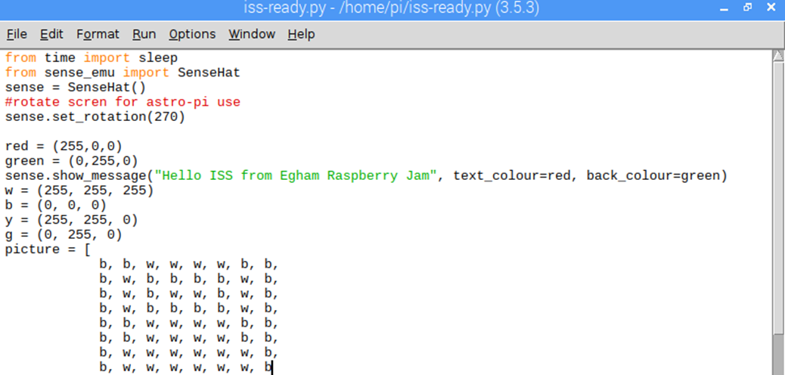
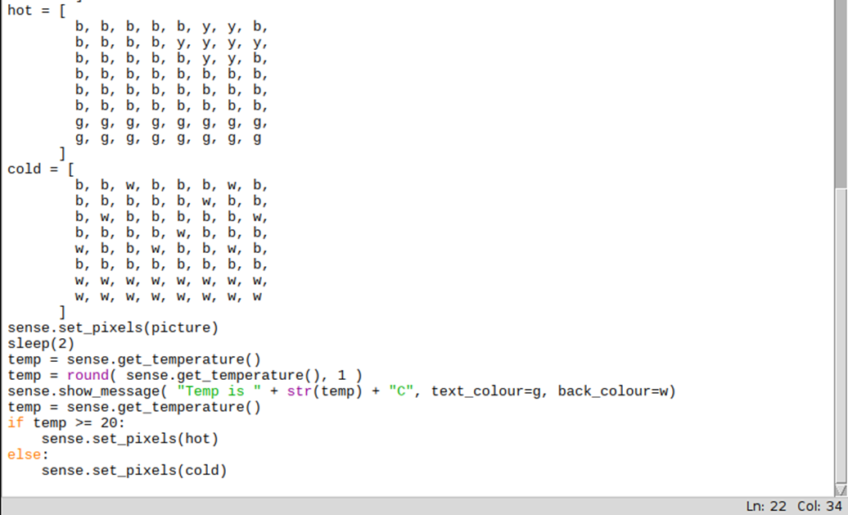
Sample Code

Slide 16
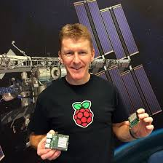



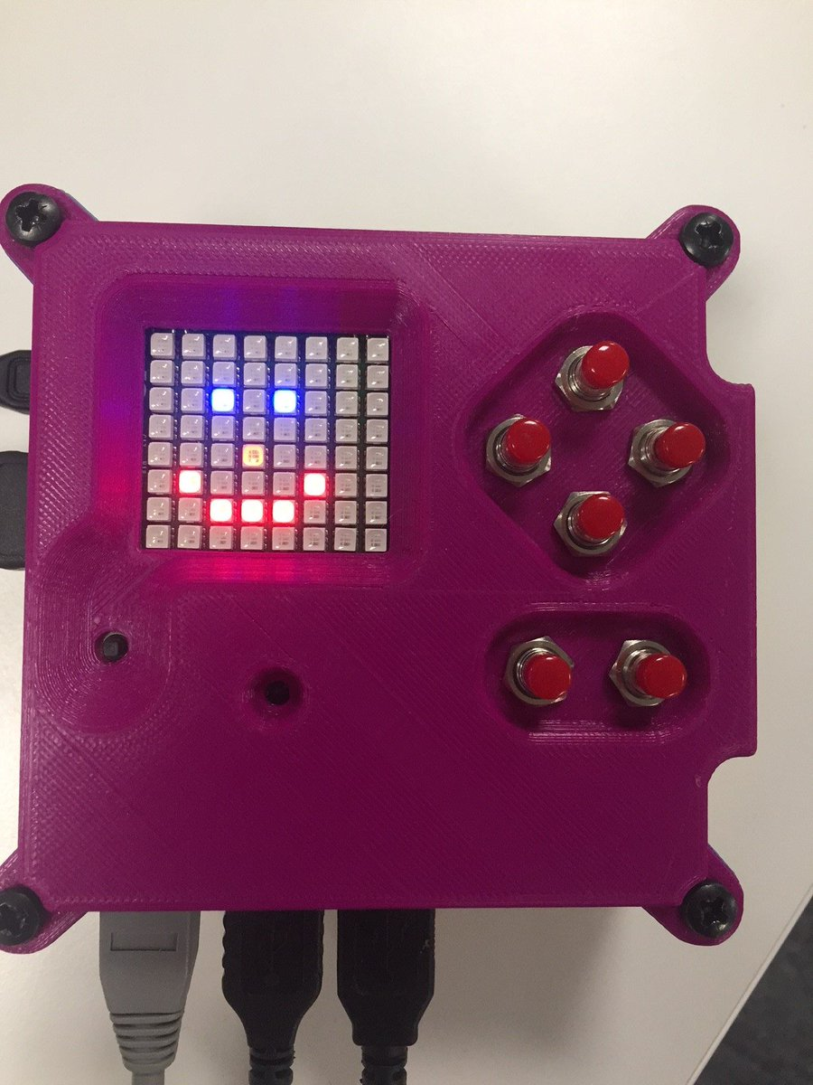
Resources
https://astro-pi.org/missions/zero/
https://trinket.io/sense-hat
https://chertseyradioclub.blogspot.com
chertseyradioclub@Hotmail.com
Twitter: @chertseyrc
Twitter: @eghamjam
Twitter: @astro_pi

